Slide 1
Loop
Rakib Mahmud

Slide 2
Introduction
Loops in programming are used to repeat a block of code until the specified condition is met.
A loop statement allows programmers to execute a statement or group of statements multiple times without repetition of code.

Slide 3
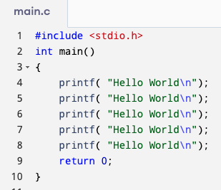
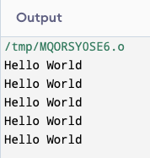
Introduction

Slide 4
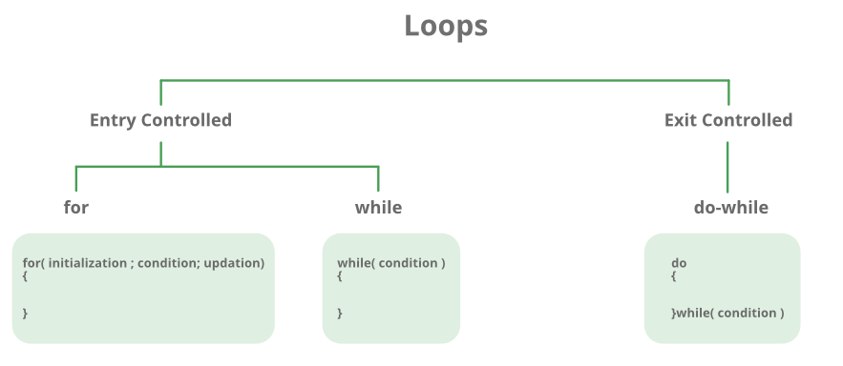
Categories

Slide 5
Categories
Entry Controlled loops:
In Entry controlled loops the test condition is checked before entering the main body of the loop.
Exit Controlled loops:
In Exit controlled loops the test condition is evaluated at the end of the loop body.
The loop body will execute at least once, irrespective of whether the condition is true or false.

Slide 6
for loop
Flow chart:
Start
Initialisation Expression
Test Condition
False
True
Block of Statements
Update Expression
Stop

Slide 7
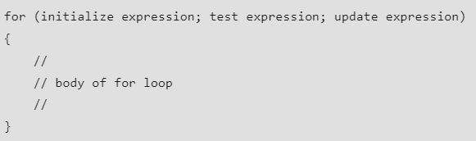
for loop (Cont’d)
Syntax:

Slide 8
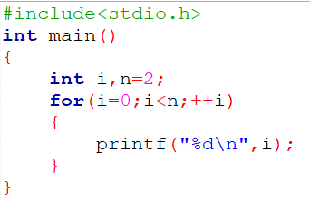

for loop (Ex1) (Cont’d)
Output

Slide 9
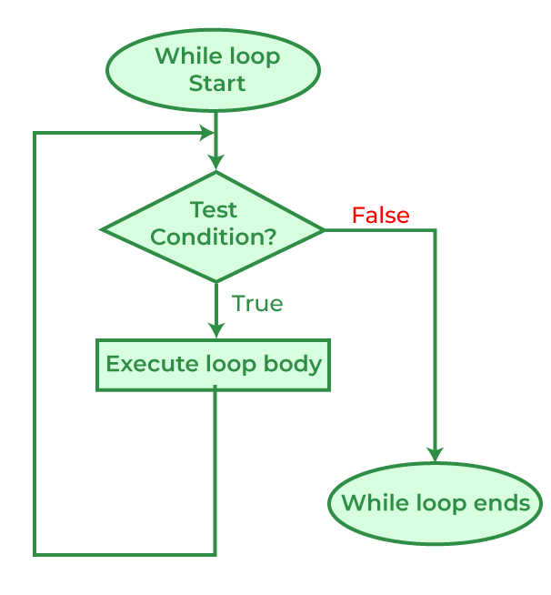
While loop
Flow Chart

Slide 10
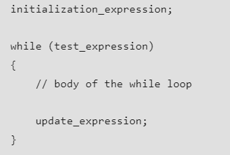
While loop (Cont’d)
Syntax

Slide 11
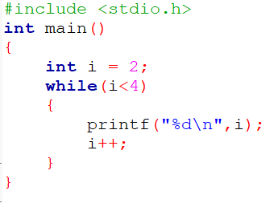

While loop (Ex1) (Cont’d)
Output

Slide 12
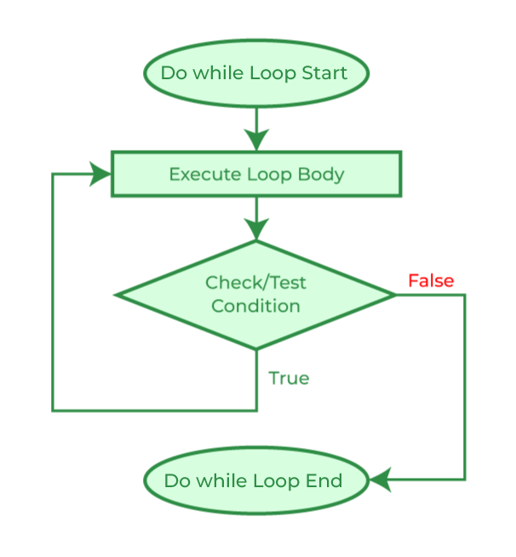
Do While loop
Flowchart

Slide 13
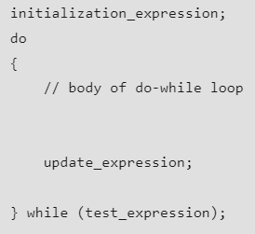
Do While loop (Cont’d)
Syntax

Slide 14
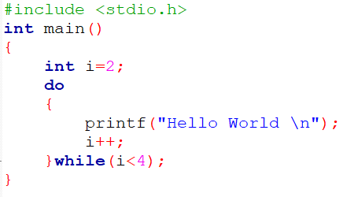

Do While loop (Ex1) (Cont’d)
Output

Slide 15
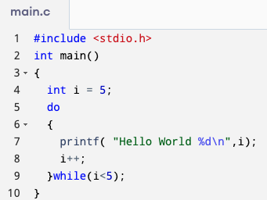
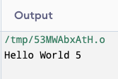
Do While loop (Ex2) (Cont’d)

Slide 16
while vs do while loop
Aspect | While Loop | Do-While Loop
Condition Check | Beginning | End
Minimum Executions | 0 | 1
Execution Guarantee | No guarantee | At least once
Semicolon | No semicolon at the end of while. while(condition) | Semicolon at the end of while. while(condition);

Slide 17
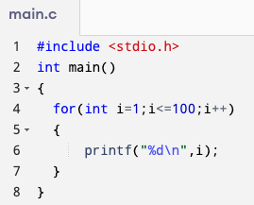
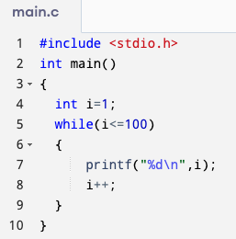
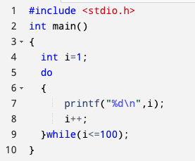
Printing (1 to 100) with various loops
while loop
do while loop
for loop

Slide 18
Nested Loops
It is also possible to place a loop inside another loop. This is called a nested loop.
The "inner loop" will be executed one time for each iteration of the "outer loop”.

Slide 19
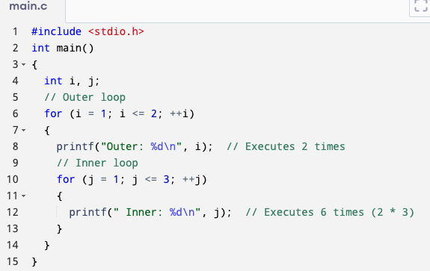
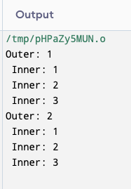
Nested Loops (Cont’d)

Slide 20
Infinite Loop
An infinite loop is executed when the test expression never becomes false and the body of the loop is executed repeatedly.
A program is stuck in an Infinite loop when the condition is always true.

Slide 21
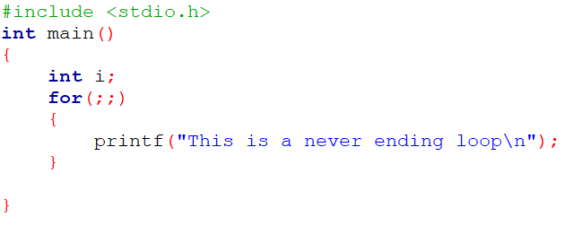
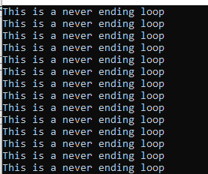
Infinite Loop (Cont’d)
Output

Slide 22
Loop control statements
Name | Description
break statement | The break statement is used to terminate the switch and loop statement. (loop terminate)
continue statement | This statement skips the rest of the loop statement and starts the next iteration of the loop to take place. (bypass)
goto statement | The goto statement transfers the control to the labeled statement.

Slide 23
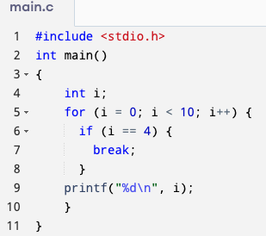
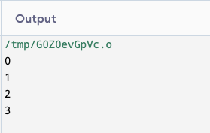
break statement

Slide 24
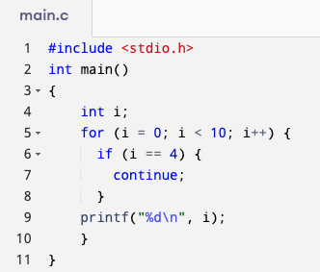
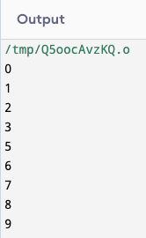
continue statement

Slide 25
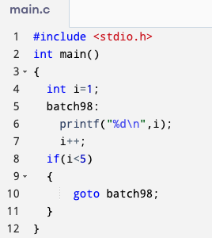
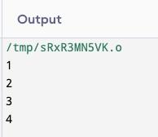
goto statement

Slide 26
Thank You

